Slide 1
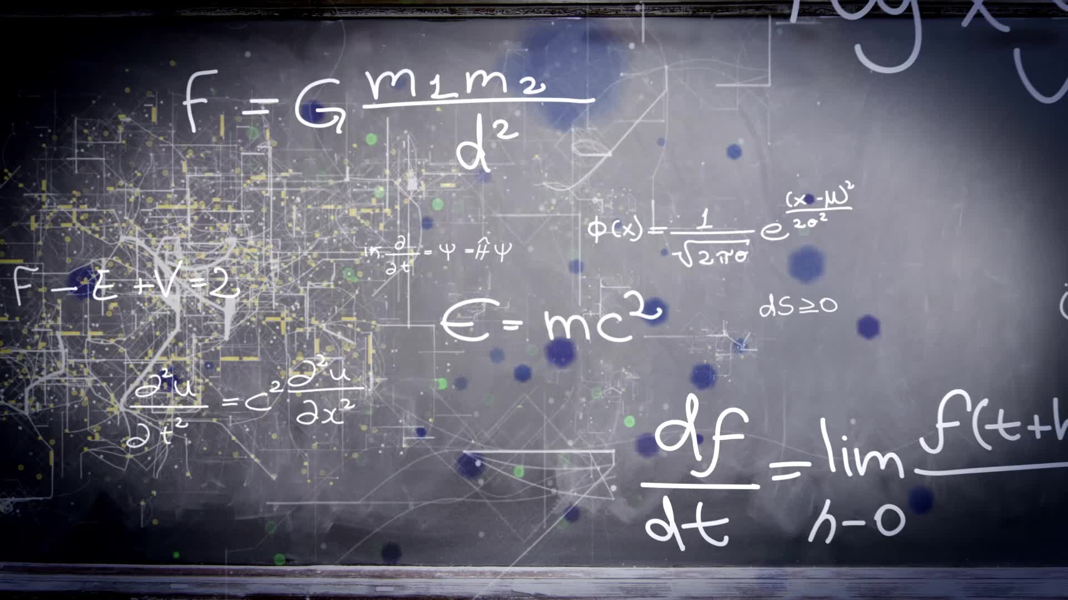
Chapter 2.3:
Differentiation Rules For Products, Quotients, Secants, and Tangents
HONORS CALCULUS/CALCULUS

Slide 2
Product Rule
$$\frac{d}{dx}\left[f(x)∙g(x)\right]=f\left(x\right)g^{′}\left(x\right)+g\left(x\right)f′(x)$$
Ex. 1)
$$f\left(x\right)=(3x−2x^{2})(5+4x)$$

Slide 3
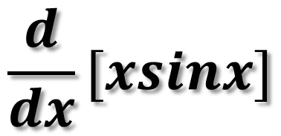
Ex. 2)
Ex. 3)
$$\frac{d}{dx}[xsinx]$$
$$y=2x cos x−2sinx$$

Slide 4
Ex. 4)
$$f\left(x\right)=(\frac{2}{x}+x)(x^{3}+1)$$

Slide 5
Ex. 5)
$$y=(1+\sqrt{x^{3}})(x^{−3}−2\sqrt{x})$$

Slide 6
Quotient Rule
$$\frac{d}{dx}\left[\frac{f\left(x\right)}{g\left(x\right)}\right]=\frac{g\left(x\right)f^{′}\left(x\right)+f\left(x\right)g^{′}\left(x\right)}{{\left[g\left(x\right)\right]}^{2}}$$
$$\frac{LoDeHi−HiDeLo}{{\left[Lo\right]}^{2}}$$

Slide 7
Ex. 1)
$$y=\frac{2x^{2}−4x+3}{2−3x}$$

Slide 8
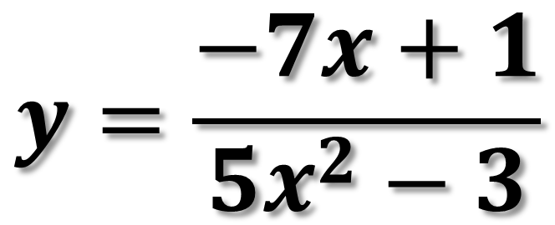
Ex. 2)
$$y=\frac{−7x+1}{5x^{2}−3}$$

Slide 9
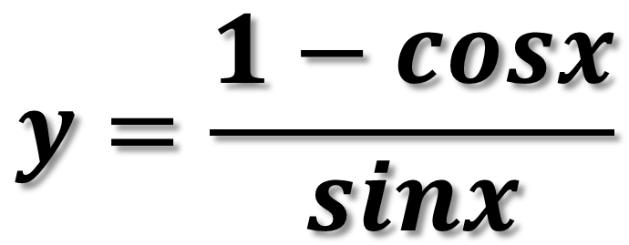
Ex. 3)
$$y=\frac{1−cosx}{sinx}$$

Slide 10
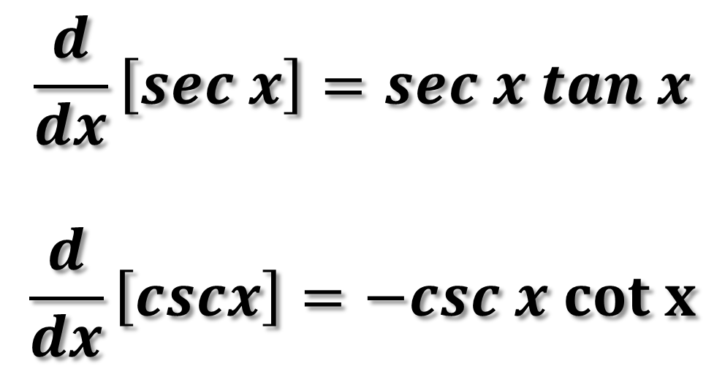
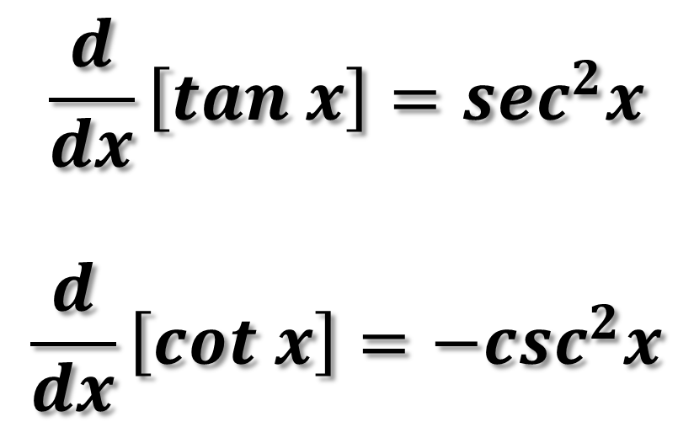
Derivatives of Trigonometric Functions
$$\frac{d}{dx}\left[tan x\right]=sec^{2}x$$
$$\frac{d}{dx}\left[cot x\right]=−csc^{2}x$$
$$\frac{d}{dx}\left[sec x\right]=sec x tan x$$
$$\frac{d}{dx}\left[cscx\right]=−csc x cot x$$
Because of the trigonometric identities, the derivative of a trigonometric function may have many forms. This presents a challenge when you are trying to match your answers to those given ones.

Slide 11
Ex. 1)
$$y=x−tan x$$

Slide 12
Ex. 2)
$$y=x sec x$$

Slide 13
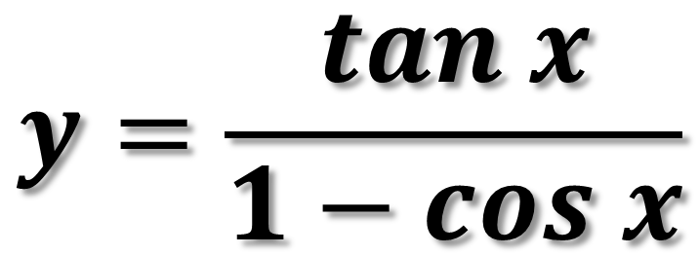
Ex. 3)
$$y=\frac{tan x}{1−cos x}$$

Slide 14
Ex. 4)
$$g\left(x\right)=sec x+9x^{5} csc x$$

Slide 15
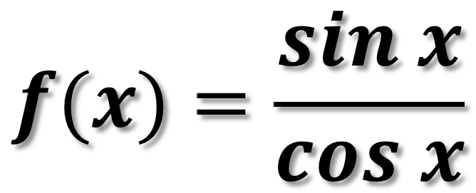
Ex. 5)
$$f(x)=\frac{sin x}{cos x}$$

Slide 16
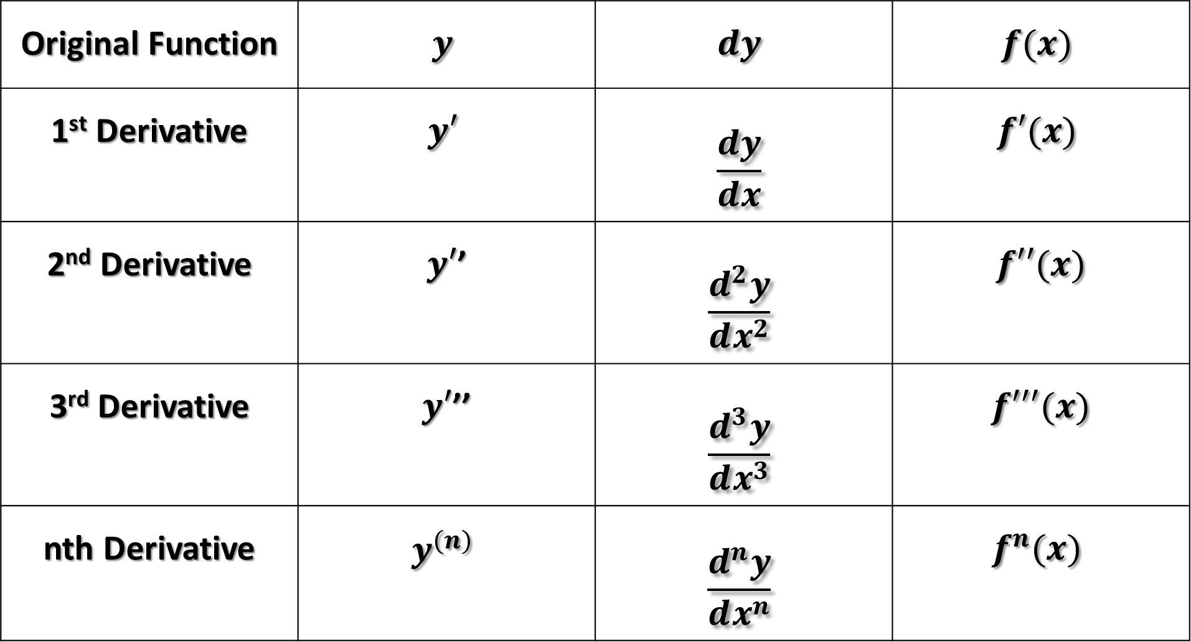
Higher Order Derivatives
Original Function | $$y$$ | $$dy$$ | $$f(x)$$
1st Derivative | $$y′$$ | $$\frac{dy}{dx}$$ | $$f′(x)$$
2nd Derivative | $y′$’ | $$\frac{d^{2}y}{dx^{2}}$$ | $$f′′(x)$$
3rd Derivative | $y′$’’ | $$\frac{d^{3}y}{dx^{3}}$$ | $$f′′′(x)$$
nth Derivative | $$y^{(n)}$$ | $$\frac{d^{n}y}{dx^{n}}$$ | $$f^{n}(x)$$

Slide 17
Ex. 1) Find the 6th Derivative
$$f\left(x\right)=8x^{7}−3x^{6}+3x^{3}−2x^{2}−1$$

Slide 18
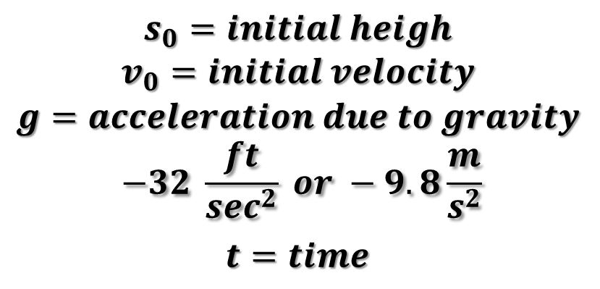
The Average Rate of Change (Average Velocity) in distance with respect to time is give by:
$$\frac{change in distance}{change in time}=\frac{∆s}{∆t}$$
Position Function:
$$s_{0}=initial heigh$$
$$v_{0}=initial velocity$$
$$g=acceleration due to gravity$$
$$−32 \frac{ft}{\sec^{2}} or −9.8\frac{m}{s^{2}}$$
$$t=time$$
$$s\left(t\right)=\frac{1}{2}gt^{2}+v_{0}t+s_{0}$$
Instantaneous Velocity:
$$s^{′}(t)=v(t)$$

Slide 19
Position, Velocity, Acceleration
Position Function:
$$s\left(t\right)$$
Velocity Function:
$$s′(t)=v(t)$$
Acceleration Function:
$$s^{′\left(t\right)}=v(t)$$

Slide 20
At time $t=0$, a diver jumps from a diving board that is $32 feet$above the water. The position of the diver is given by $s\left(t\right)=−16t^{2}+16t+32$ where $s$ is measured in feet and $t$ in seconds.
When does the diver hit the water?
What is the diver’s velocity at impact?
What is the acceleration of the diver?

Slide 21
b) What is the diver’s velocity at impact?
c) What is the acceleration of the diver?

Slide 22
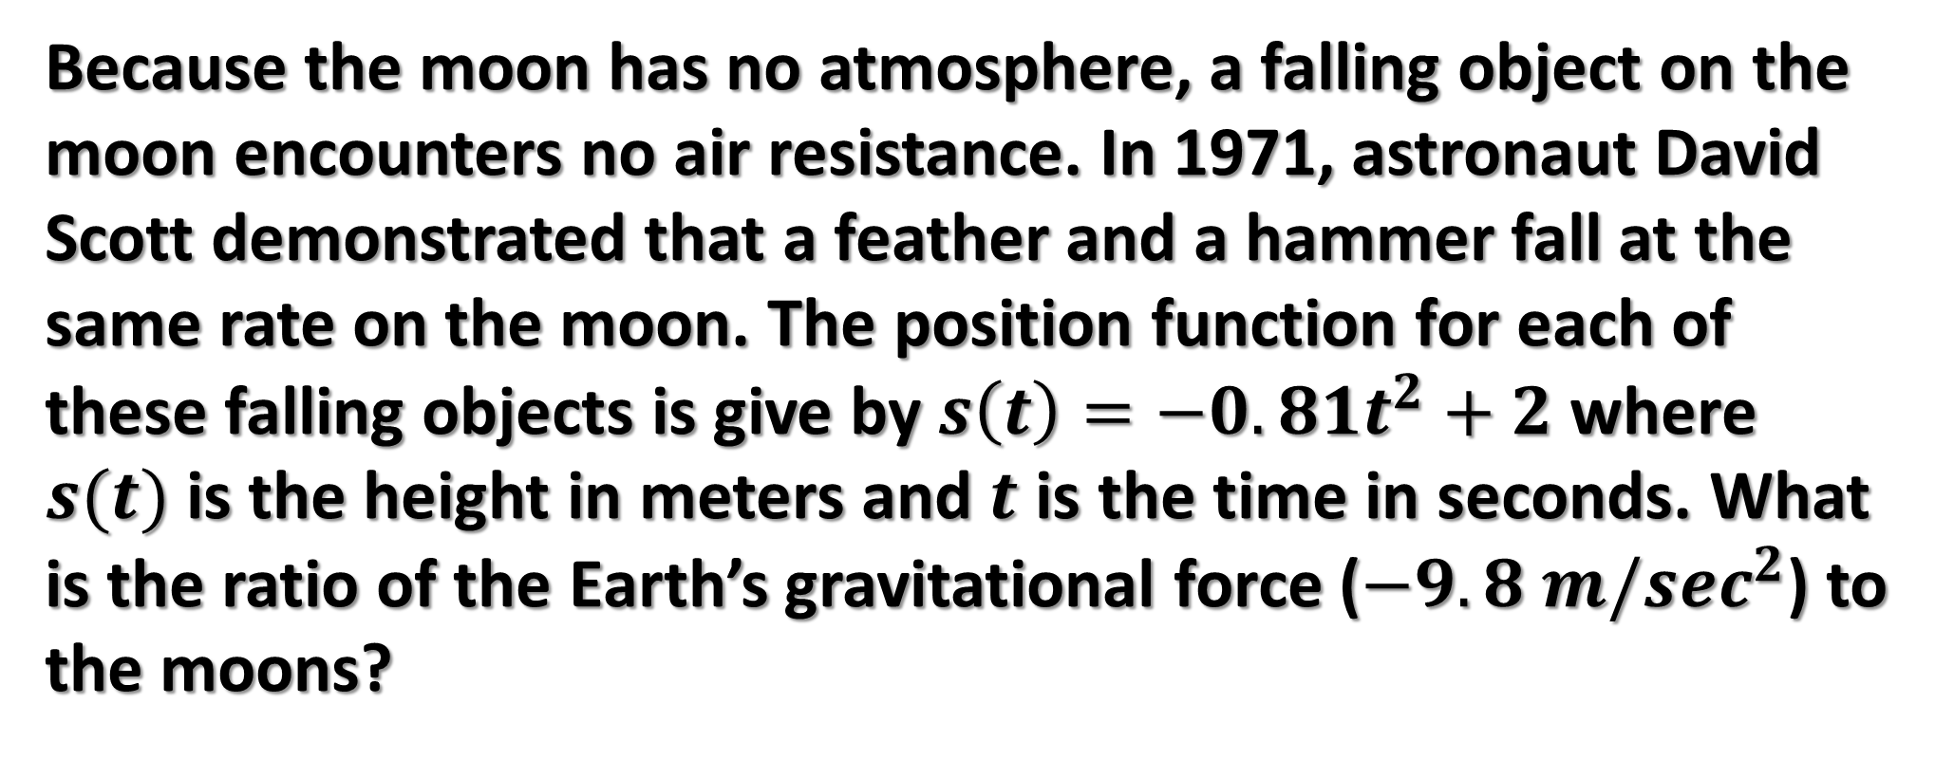
Finding Acceleration Due to Gravity
Because the moon has no atmosphere, a falling object on the moon encounters no air resistance. In 1971, astronaut David Scott demonstrated that a feather and a hammer fall at the same rate on the moon. The position function for each of these falling objects is give by $s\left(t\right)=−0.81t^{2}+2$ where $s(t)$ is the height in meters and $t$ is the time in seconds. What is the ratio of the Earth’s gravitational force ($−9.8 m/sec^{2}$) to the moons?

Slide 23
Finding Acceleration Due to Gravity
$$s\left(t\right)=−0.81t^{2}+2$$
What is the ratio of the Earth’s gravitational force ($−9.8 m/sec^{2}$) to the moons?

